Slide 1
Value Added Recognition
Teacher’s Guide
2025-2026
Prepared by the WQTA

Slide 2
Value Added:
In a nutshell
Value Added funds have been negotiated in our Provincial Entente with the goal of recognizing teachers who work with students outside of their normal working day
In 2025-2026, an allocation of a minimum of 100% of the funds was negotiated by the WQSB and the WQTA to be directed to recognize Value Added activities
Teachers must complete the appropriate paperwork to apply for Value Added funding
Only activities working directly with students outside of a teacher’s workload (outside of teaching time, homeroom, supervision, remediation), can be recognized for Value Added compensation

Slide 3
Value Added:
The Steps
The Principal will notify teachers of pre-approved activities eligible for Value Added funds. Any other activity must first be approved by the Principal (see exemplar of “Pre-approved Activities List”).
Any teacher wishing to apply for Value Added funds MUST keep a detailed daily log (see “Value Added Activity Log”)
The school must create a School Level Value Added Committee to oversee the process and applications. This committee may be a subcommittee formed by School Council. The committee will consist of an administrator and teachers.

Slide 4
Value Added:
The Steps (cont…)
Each teacher will use their log to complete the “Value Added Credit Application Form”
In order to apply for Value Added funds, each teacher must submit the following documents to the School Level Value Added Committee by May1st, 2026.
    The Value Added Credit Application Form
    The Value Added Activity Log
    A copy of the teacher’s timetable (teaching time, remediation, supervision)
Note: Activities occurring after May1st may be included in your submission
The School Level Value Added Committee will go through every submission to ensure that it has been properly completed
The Principal will approve each application with a signature

Slide 5
Value Added:
The Steps (cont…)
The Principal will send the following to the Board Level Value Added Committee, care of Pascal Proulx or Sylvie Monette, by May 15, 2025:
    For each teacher…
      The Value Added Credit Application Form
      The Value Added Activity Log
      A copy of the teacher’s timetable
      A copy of their school’s calendar including days of cycle and all PD days (ensure the school name is indicated)
      A summary sheet indicating the names of all the applicants and each of their total credits

Slide 6
Value Added: Timeline
By Oct 17, 2025: Each school creates a Value Added School Level Committee
By Oct 31, 2025 : All activities must be submitted to the principal for approval
By May 1, 2026: All teachers submit their Value Added Credit Application Forms and other required documents to the School Level Committee
By May 15, 2026: Principals submit all forms to the Board Level Committee. The Board will then collect and verify the forms.
By May 29, 2026: The Board will provide a summary of the forms for processing of payments.
June 2026: Payments will be made to teachers

Slide 7
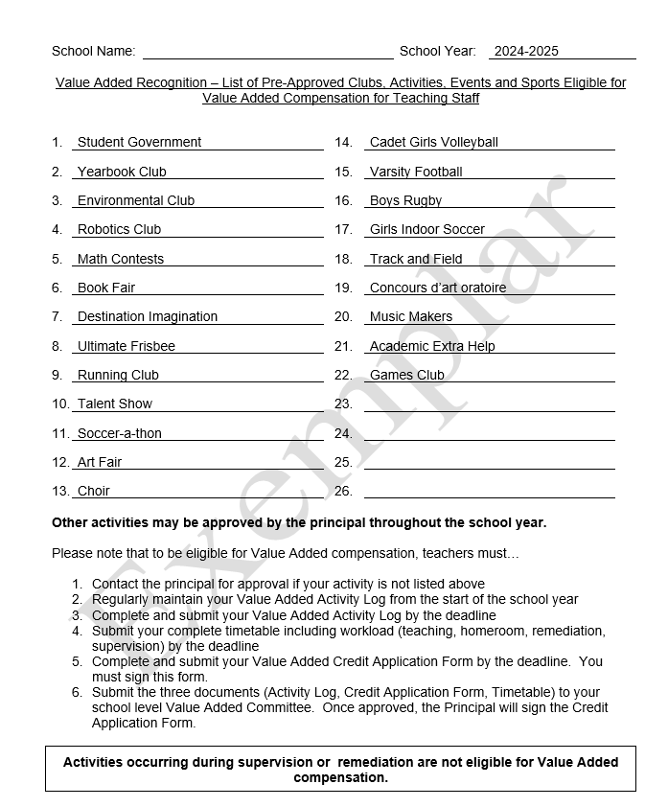
Value Added:
Pre-Approved List
Principals are encouraged to complete and distribute a list of pre-approved activities, shown here, to help facilitate the overall application and approval process
An “Exemplar” shows some of the possible activities

Slide 8
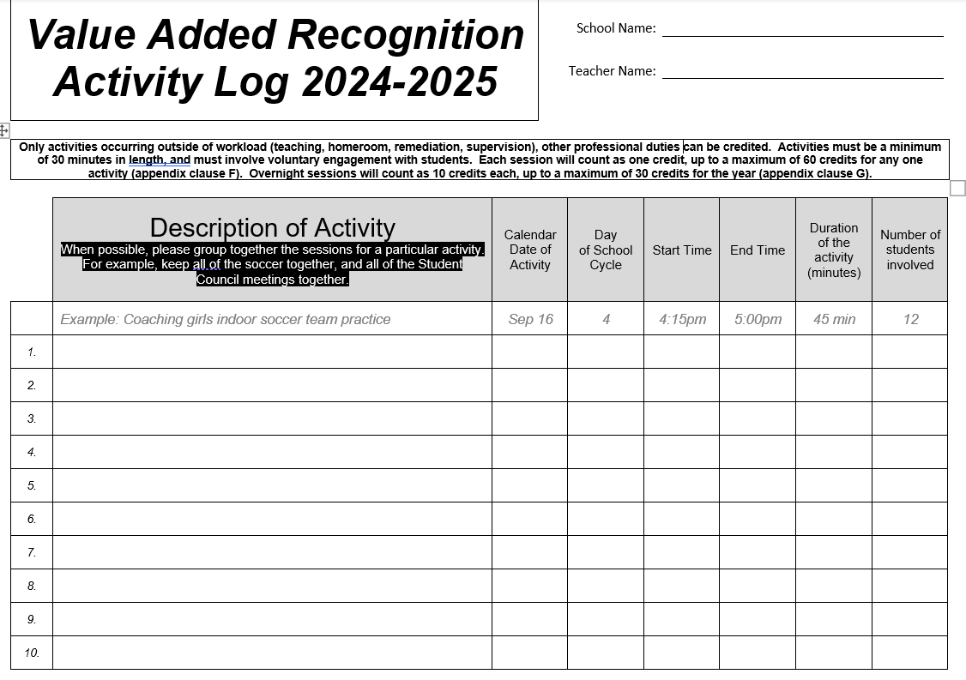
Value Added:
Activity Log
Each teacher must maintain a daily Activity Log throughout the year, using the template shown here.
The Log will be submitted to the School Level Value Added Committee

Slide 9
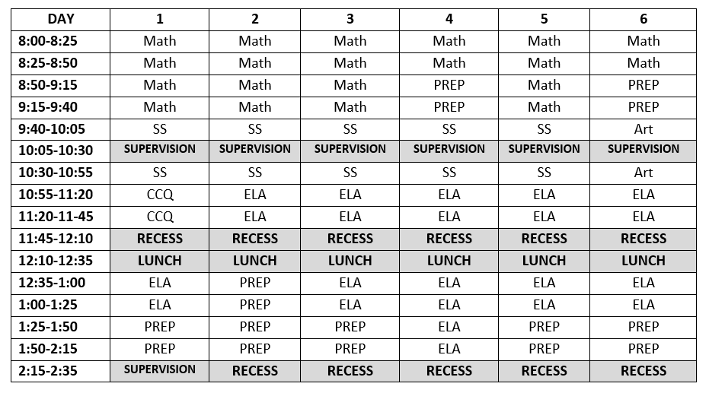
Value Added:
Teacher’s Workload
Each teacher must submit a copy of their timetable including all teaching, supervision, remediation
Example of a complete timetable

Slide 10
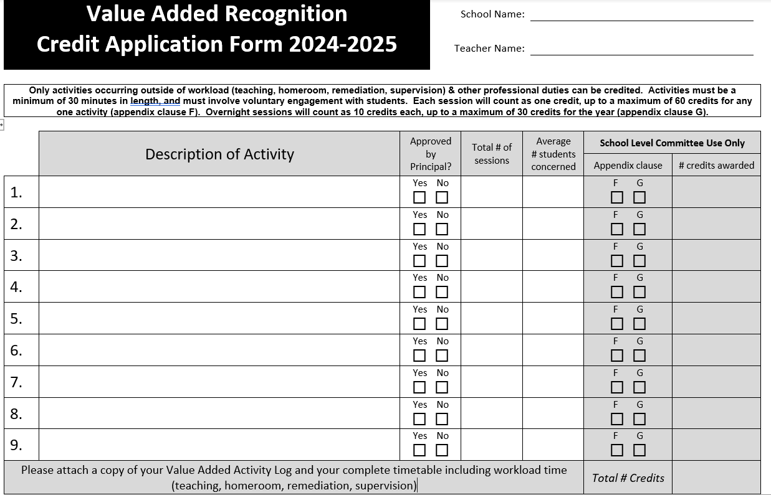
Value Added:
Credit Application Form
Each teacher must complete a Credit Application Form referencing their Activity Log
Each session (minimum of 30 minutes) will count as one credit, up to a maximum of 60 credits for any one activity
Each overnight session will count as ten credits, up to a maximum of 30 credits for the year

Slide 11
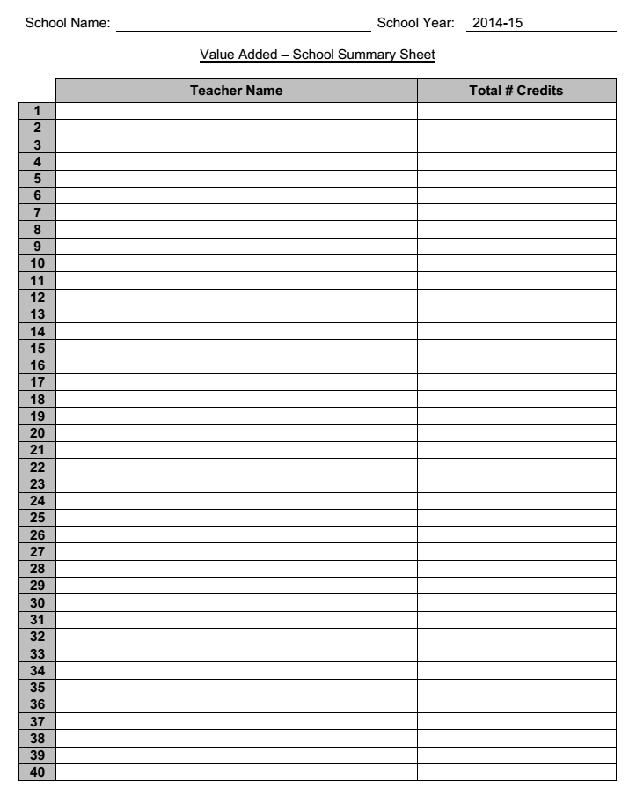
Value Added:
School Summary Sheet
Each Principal or School Level Value Added Committee must complete one School Summary sheet for the entire staff (shown here)

Slide 12
Value Added:
Frequently asked questions
Can I hold a value added twice in the same day?
During a regular workday, if a teacher holds a value added activity twice in the same day, then they will be able to claim two credits provided the requirements are met.
That is for example, a coach has a practice in the morning before school and then has a game that afternoon after school, then the teacher may claim each time for a credit.
It would be similar for a teacher who runs Destination Imagination at lunch (at least 30 minutes) and then again after school (outside of presence time), then the teacher may claim each time as a credit.
This does not apply to tournaments.

Slide 13
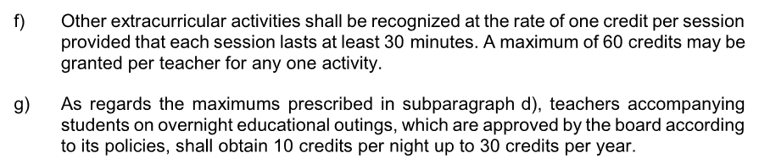
Value Added:
Frequently asked questions
To what does Appendix clause “f” and “g” refer?

Slide 14
Value Added:
Frequently asked questions
What is the minimum number of credits for one activity?
  1 credit
What is the maximum number of credits for one activity?
  60 credits. This means if you have 50 soccer practices, and 18 soccer games, you will be awarded the maximum of 60 credits (not 68 credits as a result of the number of sessions)

Slide 15
Value Added:
Frequently asked questions
Are practices and games separate activities?
  No. Practices and games for the same team are considered part of the same activity. However, they may each count as one session.
My activity lasts for 3 hours, whereas someone else’s last for 30 minutes. Shouldn’t I receive more compensation?
  No. The appendix in the Provincial Entente does not distinguish between the length of activities.

Slide 16
Value Added:
Frequently asked questions
Can I apply for Value Added funds if I have students serving a lunchtime detention?
  No. Value Added funds are intended for services beyond a teacher’s normal tasks that are voluntary for the student and for the teacher
Can I apply for Value Added funds for a school initiated program?
  No. An approved activity should be voluntary for all those involved.

Slide 17
Value Added:
Frequently asked questions
If my session runs for more than 30 minutes, can I apply for more than one credit (for example, does a two hour session count for 4 credits)?
  No. The minimum length of a session is 30 minutes but there is no maximum (for example a two hour session counts for one credit). This is outlined in the Provincial Entente.
What is the minimum number of students for an activity?
  One student is the minimum, there is no maximum. This is outlined in the Provincial Entente.

Slide 18
Value Added:
Frequently asked questions
Does a tournament count for more than one credit?
  No. The tournament is one activity however an overnight tournament would count as ten credits total.
If my school trip runs for 5 overnights, how many credits do I apply for?
  Overnight activities count for ten credits per night, up to a maximum of thirty credits per school year, regardless of the number of overnight trips.
  Once the maximum is reached, one credit will be awarded for each additional overnight.

Slide 19
Value Added:
Frequently asked questions
Does my application form require the signature of my Principal?
  Yes. If not, the form will not be processed. In addition, incomplete submissions will not be processed.
My Principal has assigned me to an activity during lunch. Can I apply for Value Added credits?
  No. The activity must be voluntary on your behalf, and on the student’s behalf.

Slide 20
Value Added:
Frequently asked questions
When will I receive my payment?
  Payments will be processed in June and will appear on your paystub. Deductions will be taken from the gross amount.
How much is one credit worth?
  The value of one credit cannot be determined until after all applications are vetted and processed. One credit is equal to the total of the Value Added fund divided by the total number of credits.

Slide 21
Value Added:
Frequently asked questions
How do I keep track of my activities?
  You must use the Value Added Activity Log. You can complete this by hand or electronically. Ensure that you are using the 2025-26 forms.
Can I apply for credits if I’m planning/coordinating activities?
  Yes if the planning/coordinating includes students present at the meetings (for example, student council planning a dance)

Slide 22
Value Added:
Frequently asked questions
Who is responsible to complete the Value Added Application Forms?
  The teacher involved in the activities must complete the forms. The Principal is only responsible to sign the form.
Does Value Added compensation replace other forms of compensation?
  No, the Value Added compensation is in addition to any other negotiated compensation.

Slide 23
Value Added:
Frequently asked questions
Who can I contact to help further explain the process?
  You can contact your WQTA Delegate, your Principal or a member of your School Level Value Added Committee
Who do I contact if there is a problem with my application?
  You should contact your Principal. The Board simply checks your form, but your principal approves the activity and the number of credits.

