Slide 2
Stronger members.
Better education for all.

Slide 3
Starling is an online preventative mental health and wellness program for QPAT-APEQ members and their families.

Slide 4
The Starling Program
Is designed specifically for teachers.
It is available both in English and French.
Helps you assess, monitor and improve your mental wellbeing.
Teaches you to take care of your mental health, just like your physical health.
Gives you practical techniques for building resilience to stress and boosting mental fitness.
Is available to you to use anywhere and anytime you want.
Is and will always be 100% confidential.

Slide 5



Starling Strengthens the Entire Membership
Awareness & Prevention
Starling’s focus is mental wellness – not mental illness. Whether you feel great, just okay, or bad, checking in with their own mental health and wellbeing is like the emotional and spiritual equivalent of getting a check-up.
Struggling members
Statistics show that 20% of Canadians will personally experience a mental illness in their lifetime*. Starling teaches you tried-and-true techniques for identifying and adjusting problematic thought patterns, for changing unhealthy behaviours, and for ultimately feeling better, healthier and stronger, then helps you practice them.
Family members
When a family member struggles with mental health issues, it affects the whole family. You can support your loved ones by referring them to create their own Starling profile or log in yourself to learn more about mental health. The goal is to provide mental health education, evidence based strategies to strengthen the family.
*Canadian Mental Health Association

Slide 6
What Starling members say
“
I learned more information that I did not know before and made notes to refer back to. I also hope to use some of these ideas and notes when I teach my students at school, helping them in their awareness of themselves, their confidence levels and accomplishments. I hope to learn more in the future modules that will help both me and my students.
”
Teacher, BCTF Member

Slide 7

Feeling stressed?
You’re not alone.
1 in 5 people experience mental illness in some point of their lifetime.* That’s 1.6 million people living in the Quebec.
Mental illness directly or indirectly affects all Canadians at some point through a family member, friend, or colleague.
*Canadian Mental Health Association

Slide 8
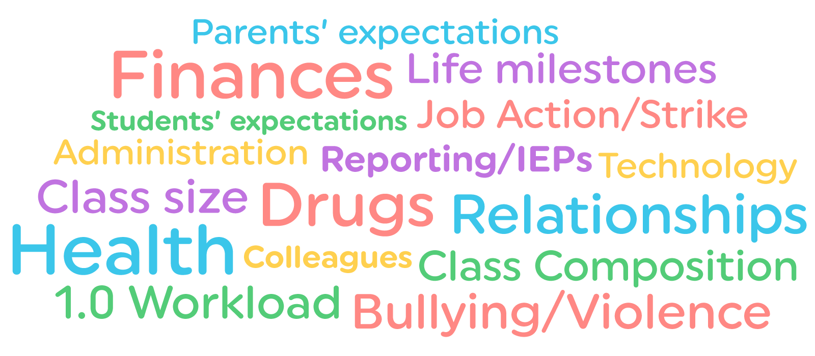
Teachers’ Stressors

Slide 9

Who Uses Starling?
Teachers, like you.
In fact, Starling was initially developed for teachers.
Starling is for people who want to learn how to take care of their own mental health so that they can be stronger and more effective in all areas of life.

Slide 10
Starling BCTF Success Story – User 992
62
logins
72
mood records
16
goal records
197
videos
watched
19
assessment
records
Still using,
latest logins in
May, 2016
Registered in
November, 2015

Slide 11
Starling Success Story – User 992
Improvements in anxiety and depression symptoms
A significant improvement in
work functioning
Depression
Anxiety
Work functioning
HEALTHY
80-100
100
HEALTHY
80-100
100
90
BORDERLINE
60 - 79
75
BORDERLINE
60 - 79
65
MILD
40 - 59
MILD
40 - 59
MODERATE
20 - 39
MODERATE
20 - 39
SEVERE
0 - 19
SEVERE
0 - 19
10
Baseline Score
Most Recent Score
Baseline Score
Most Recent Score
Notes:
Andrew - which scale should we use? Assessments symptoms’s scale or function’s scale (20, 40, 60, 80, 100)

Slide 12
True Stories from Starling Members
“
“I’m a member of Toastmasters, which is great for someone with social anxiety. People there have said to me, ‘You seem so comfortable up there.’ And I laugh and say, ‘Actually, I have anxiety disorder, panic disorder, social anxiety.’ And they can’t believe it. Because you’re so careful about how you present to the world, and no one knows you’re dying on the inside. I think people need to know. So I’m quite open with people about my mental health. My kids always say, ‘Mom, why do you tell people that?’ And it’s because I want people to know there’s no shame in it. If more people would talk about it, there would be less shame, less stigma.
“It’s that stigma that’s keeping people from speaking up, and seeking help when they’re struggling. Whether that be seeing a counsellor or therapist, or logging onto to Starling Minds. We need to normalize these topics, so everyone knows there’s no shame in accessing these supports...Because I think anyone could benefit from Starling, especially educators. Whether you have diagnosed mental health issues or not. Just log in, do the assessment, see where you land. You may not even know that what you’re experiencing isn’t normal, that you’re struggling without even realizing it. That external perspective is really useful. So are the techniques to help you get back on track.”
”
Jeanne, educator in Ontario

Slide 13

What is in the Starling Program?

Slide 14
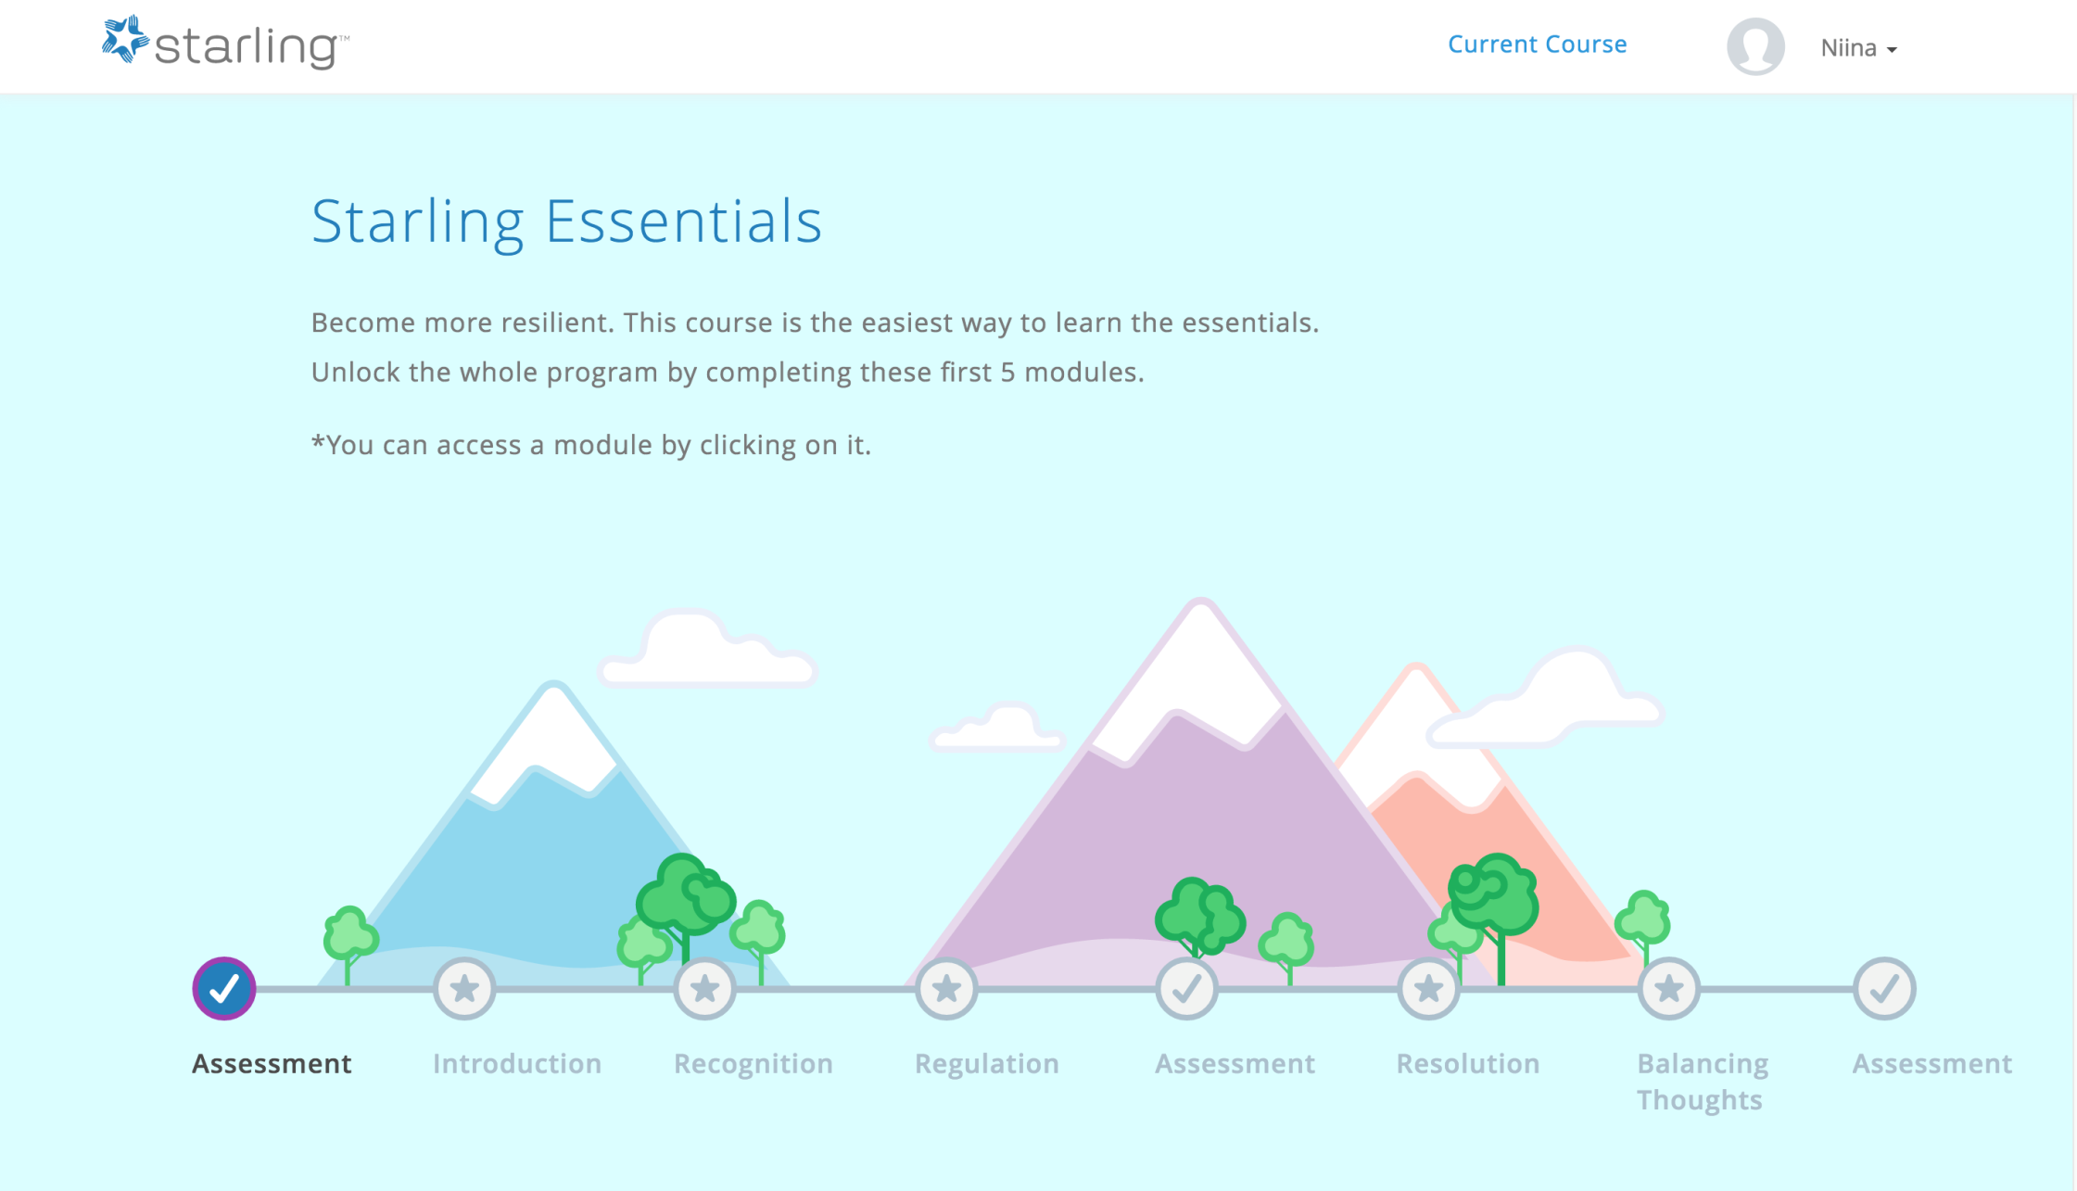
Mental Health and Wellness Education

Slide 15
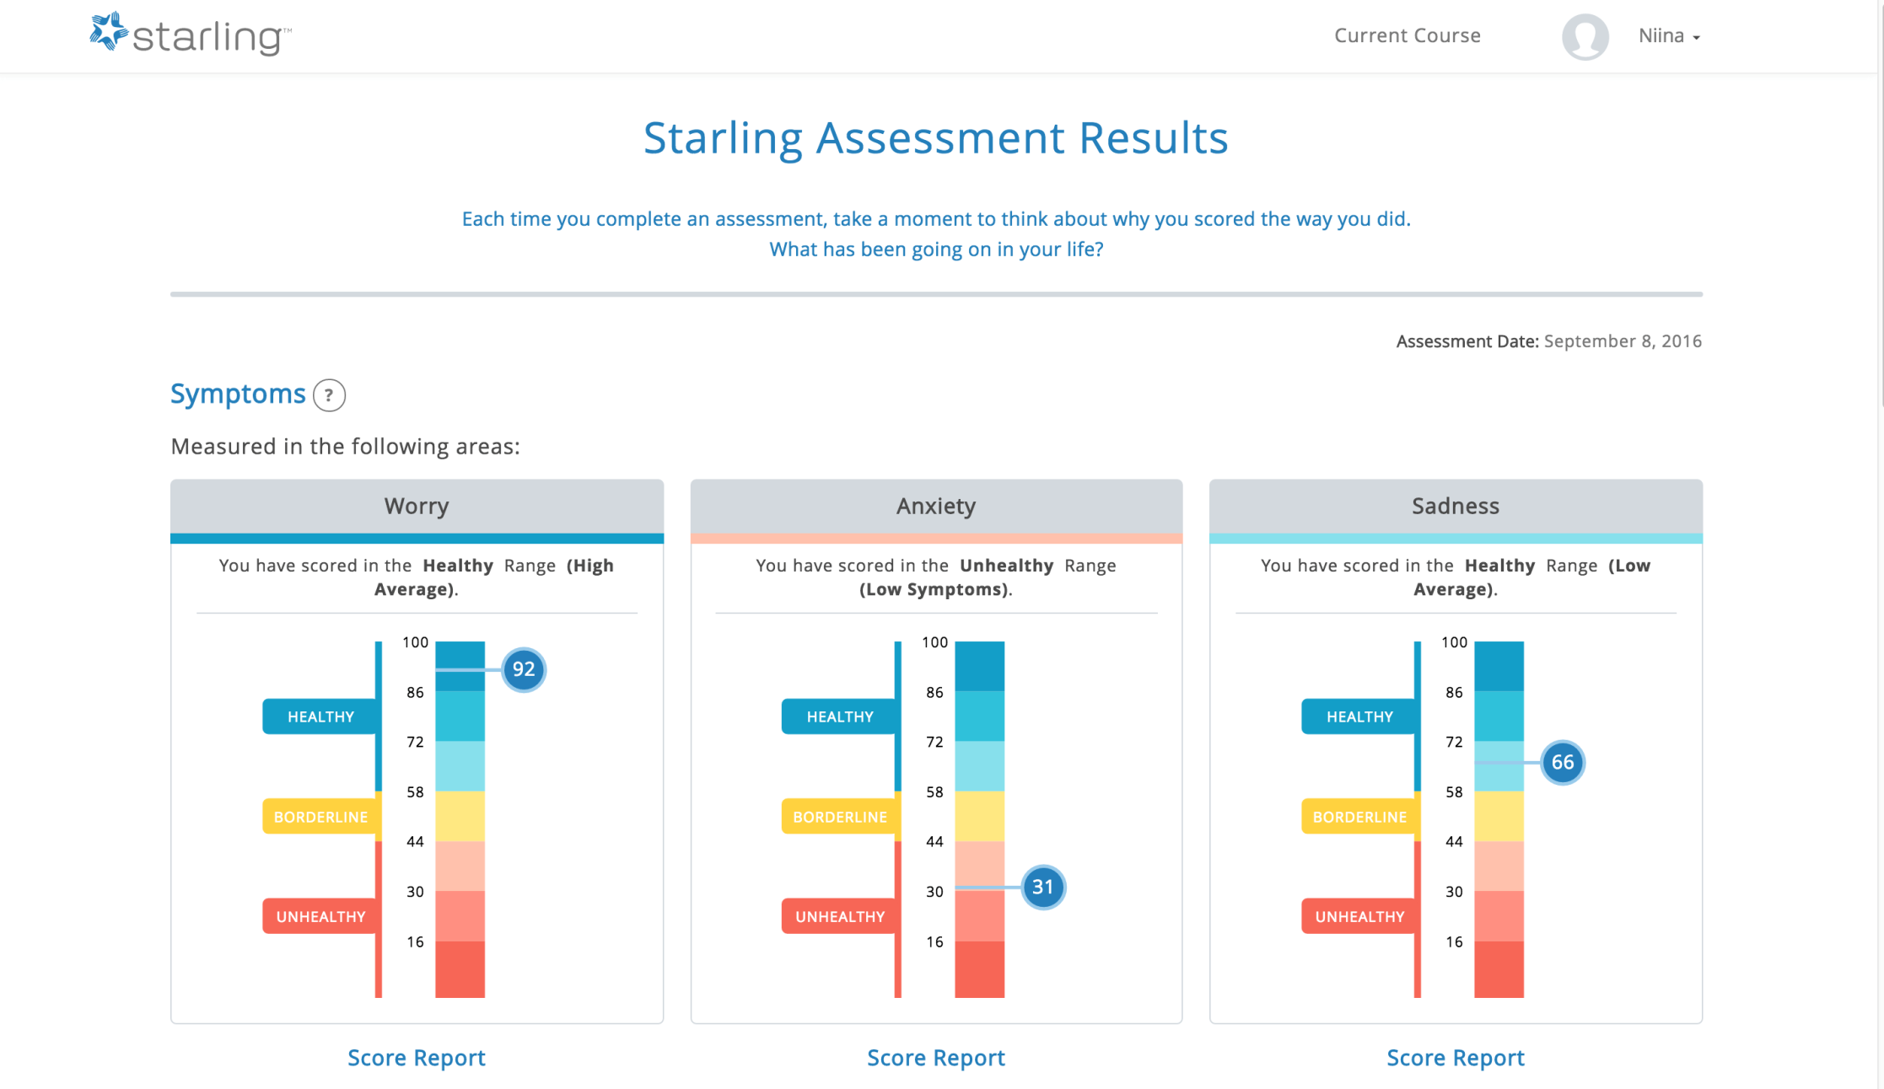
Learn About the Mental Health Continuum

Slide 16

Watch Case Study Videos of a Teacher Named Virginia

Slide 17
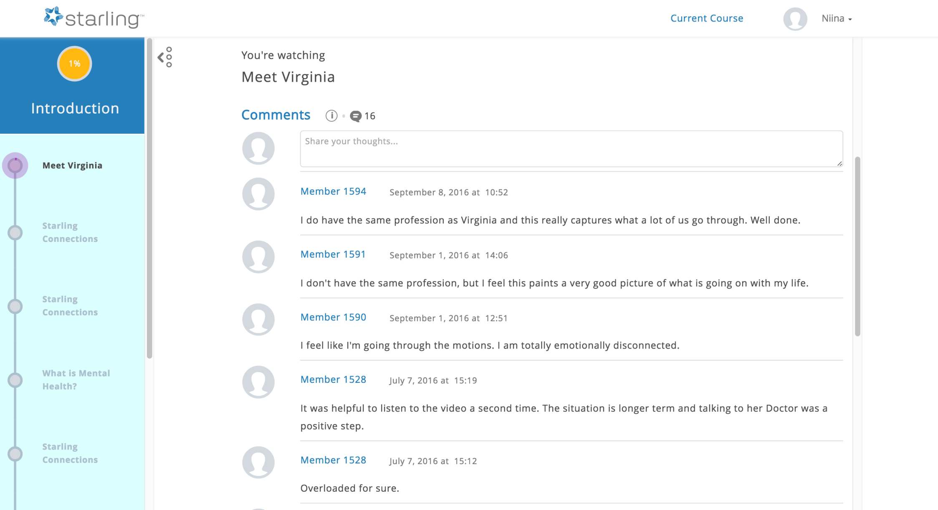
A Social Forum to Discuss Sensitive Topics Anonymously

Slide 18
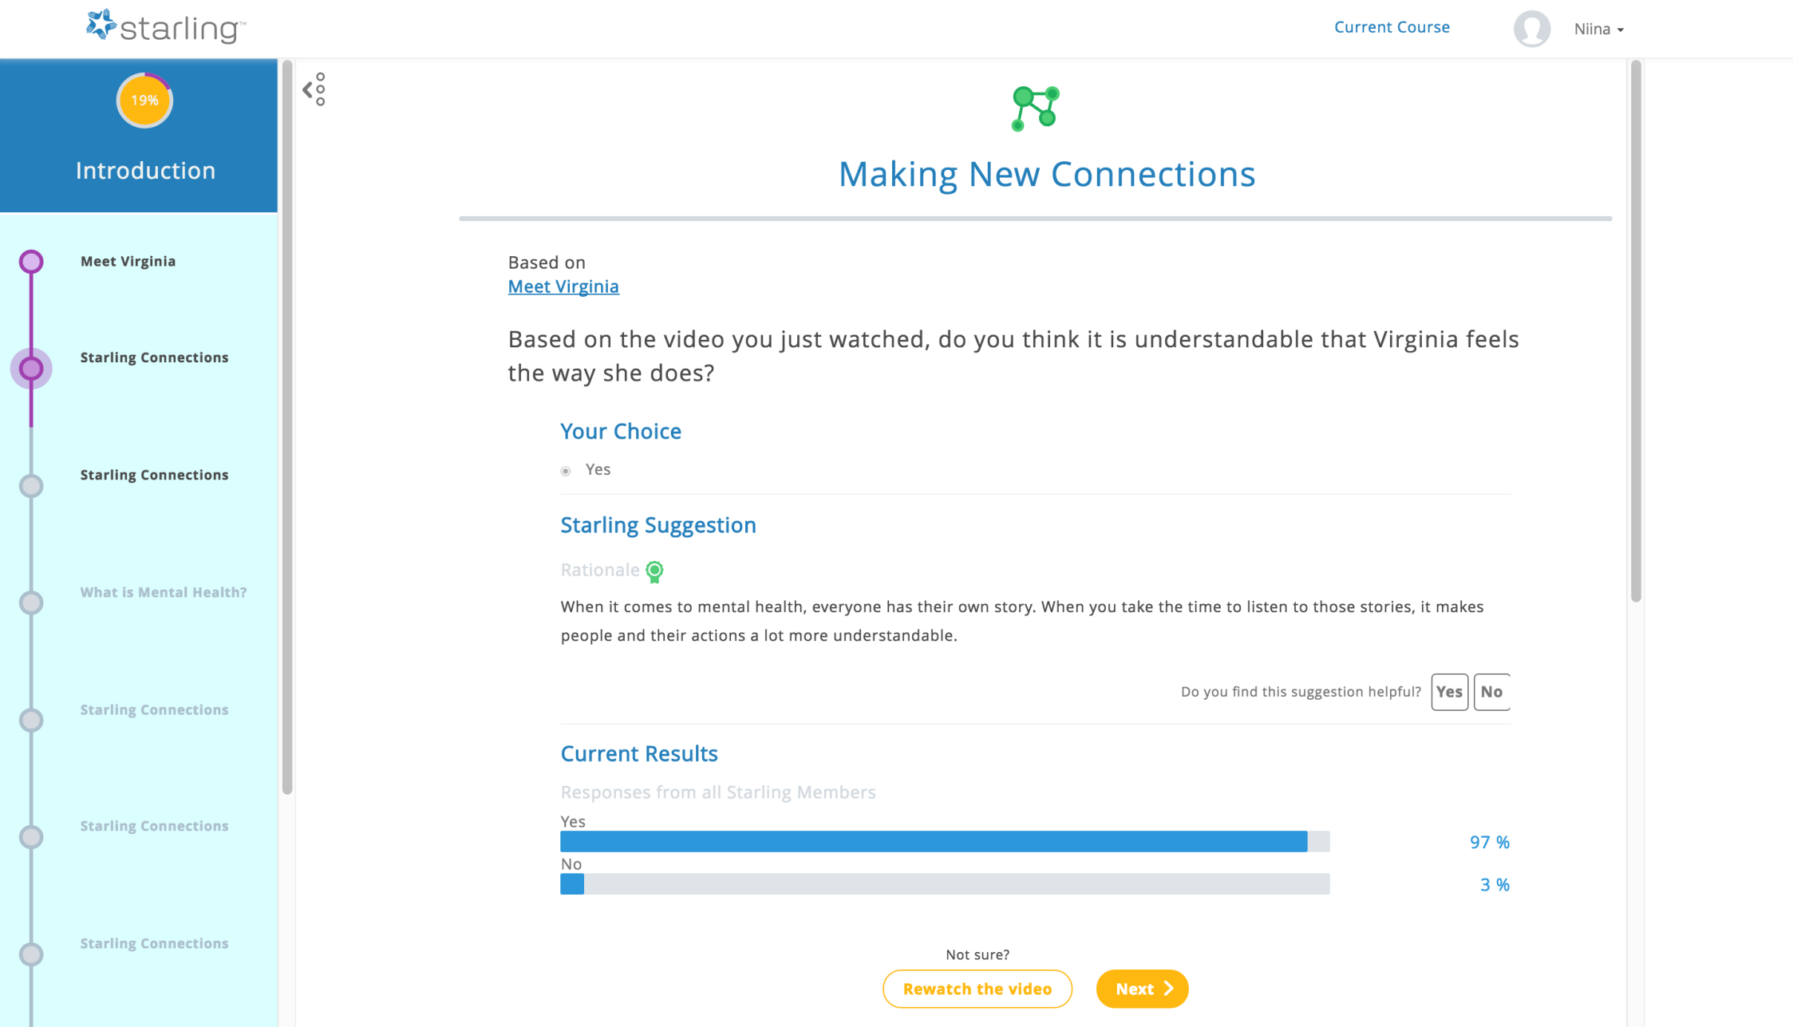
Interactive Questions with Community Feedback

Slide 19
Launching the Starling program

Slide 20
Next Steps
Soft launch on October 3rd
Program launch on October 17th
Featuring
  A five module preventative mental health program with early intervention modules for anxiety and/or depression in English and French
  Starling analyses assessment results to unique recommendations for each user
  Family referral capability (will be available on October 17th)
Comprehensive communications plan for 2016

Slide 21
Comms Plan 2016
Announcement to the members of the Starling program and its availability through QPAT-APEQ’s digital channels
Internet page that describes the Starling program with a link to sign up page
Dr. Miki to present Starling at QPAT Convention, November 24 ⁻ 25
Continuous monthly promotion through QPAT-APEQ and local unions

Slide 22
Launch Assets
Available in English and French on Oct 3rd
Quick Tip one-pager
Launch e-mail
Blog post
Newsletter article
FAQ sheet for accessing the Starling Program
Print materials
  Postcards for distribution to prospective users and leave in staff common spaces (e.g. lunch rooms)
  PDF on poster for lunch/staff rooms
Quarterly updated comms calendar
Sign up by sending an e-mail to niina@starlingminds.com

Slide 23

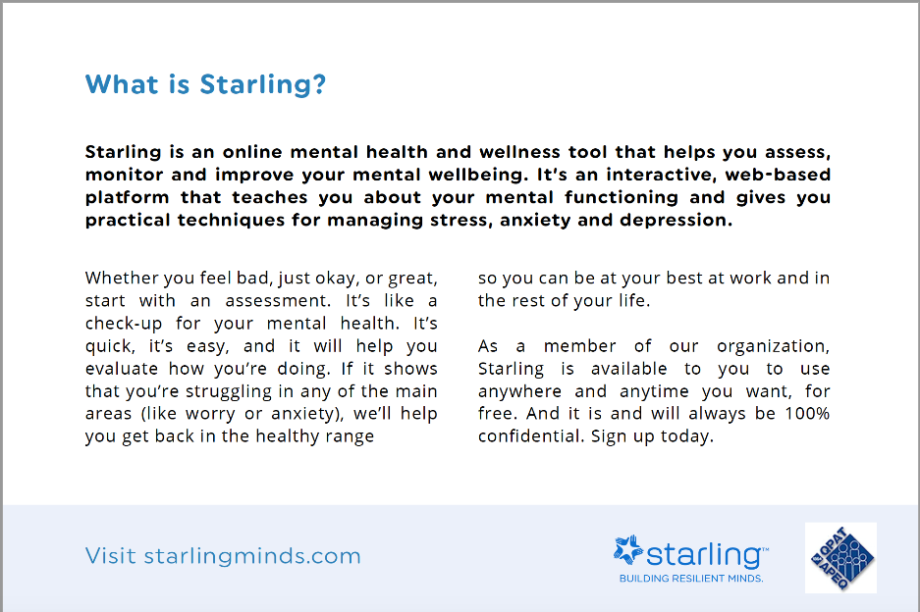
Starling Monthly Toolkit
Available in English and French
Blog post
Newsletter article
Social media content (text and visuals)
Sign up at www.starlingminds.com/toolkit

Slide 24
Thank you
Visit us at:
starlingminds.com
Contact us at:
members@starlingminds.com

